Slide 1

Mobile Game Design - 01 (MDEV1003)
Assignment: Final Project
Game Title: The Genius Guy
by
Mahfuz Aftab
Student Number: 200499643
Semester: Winter 2023

Slide 2
Introduction
The Genius Guy game focuses on academic purposes for preschoolers.
The Genius Guy game is designed to generate interest in learning among preschoolers through gaming.
Teaching preschoolers through The Genius Guy game will provide parents and teachers with a novel experience.

Slide 3
Game Story
The Genius Guy is a puzzle game that requires the player to solve various puzzles and problems.
While solving the puzzles, the player will need to arrange numbers in sequence.
The game also includes image and character puzzles that can help enhance the player's problem-solving skills.

Slide 4
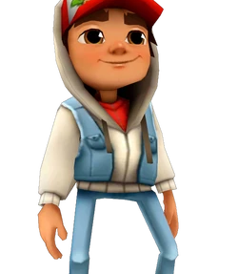
Game Name
The name “Geni” is Inspired from the word ‘Genius’
“Geni” will be the character who will play and solve the game puzzle.
Image Credits: Game Subway Surfers

Slide 5
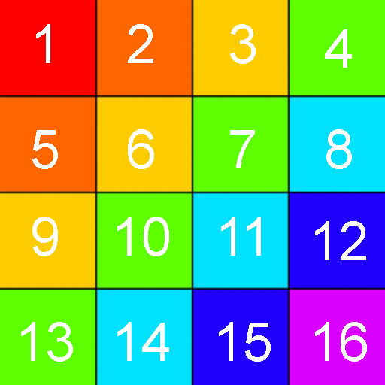
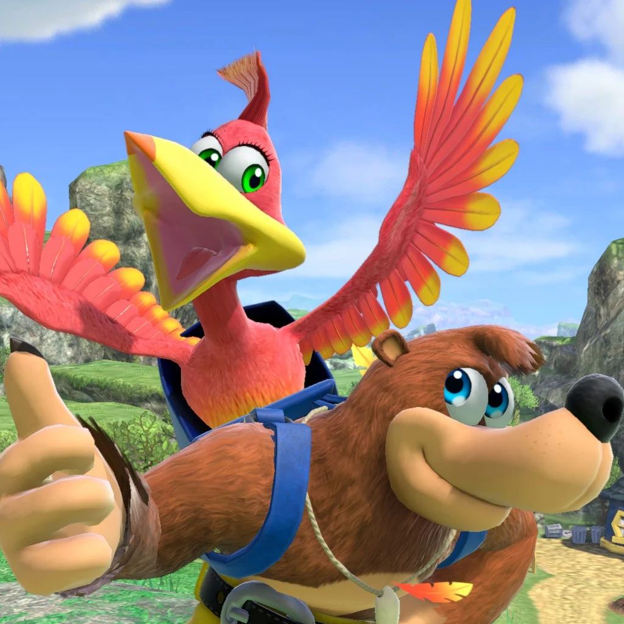
Sample Game Image Assets

Slide 6
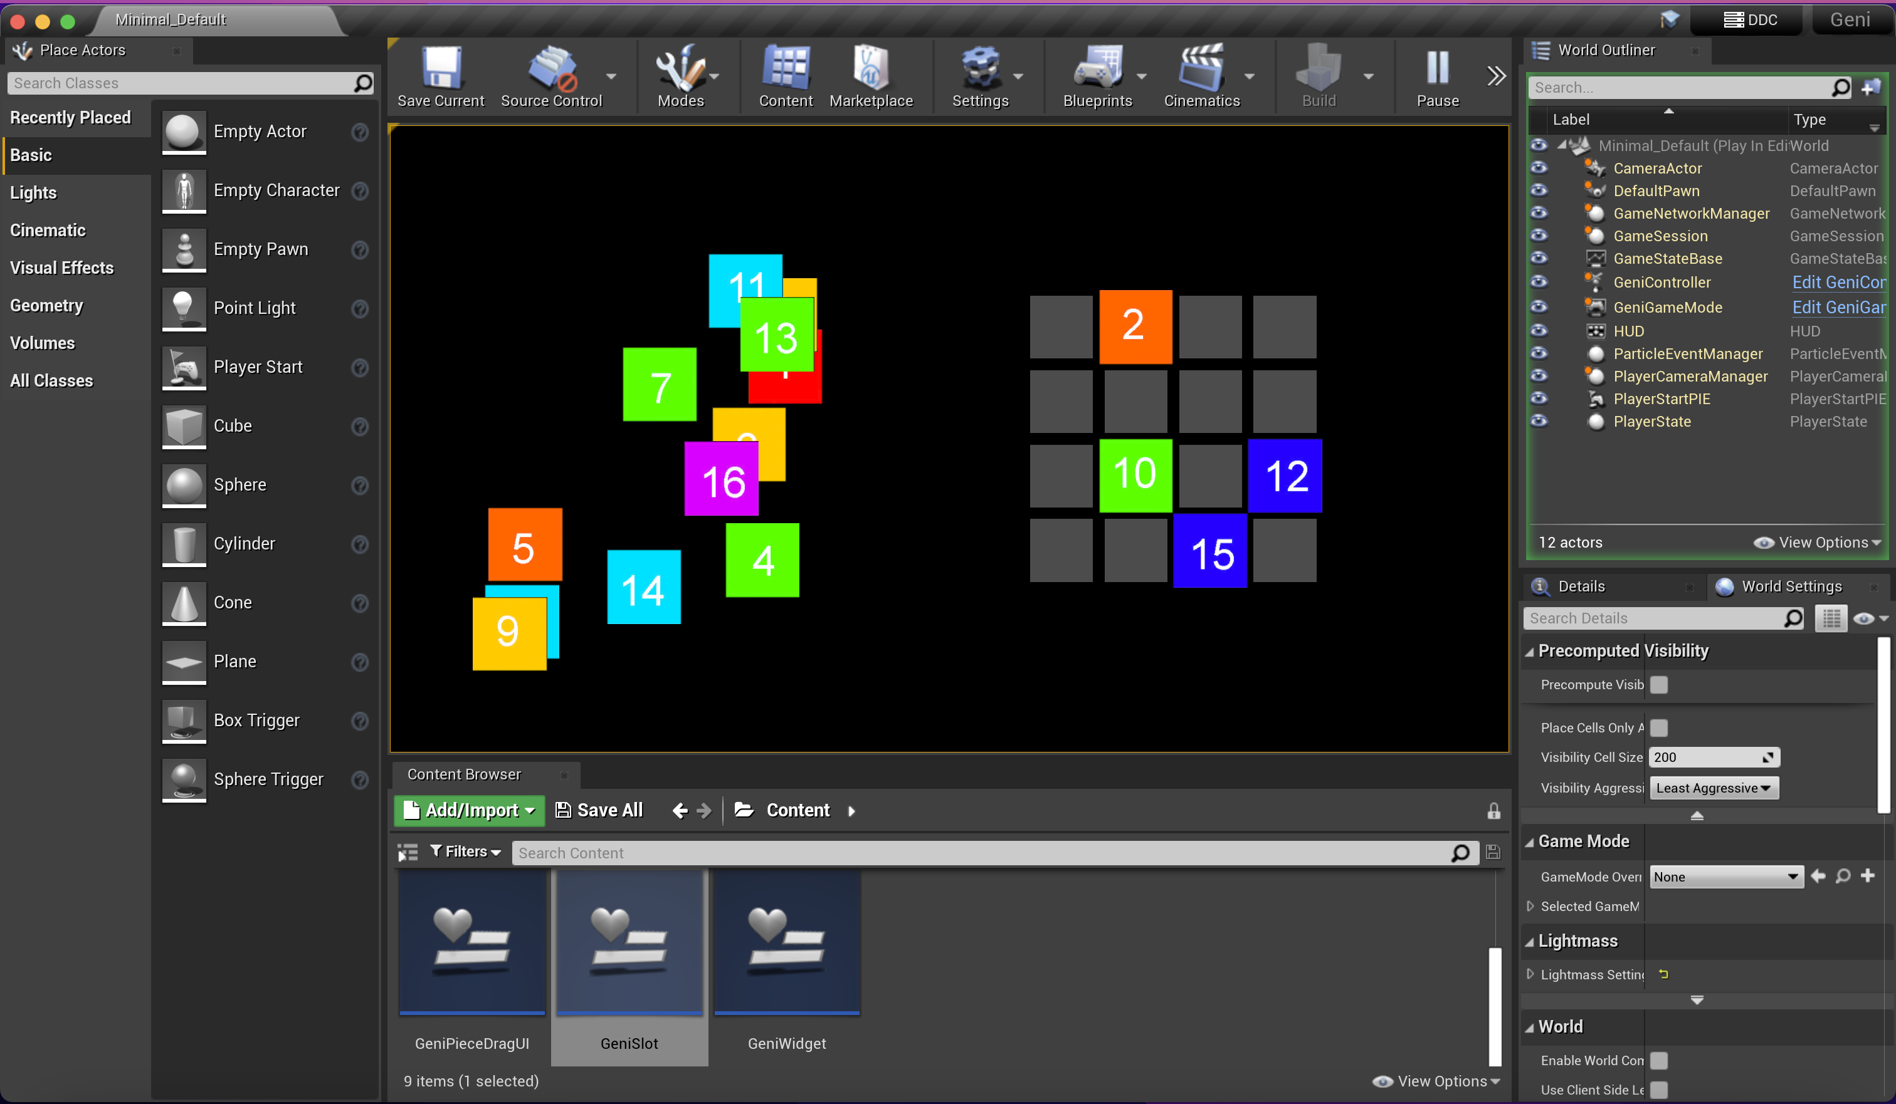
Game Play (Learning while Playing)

Slide 7
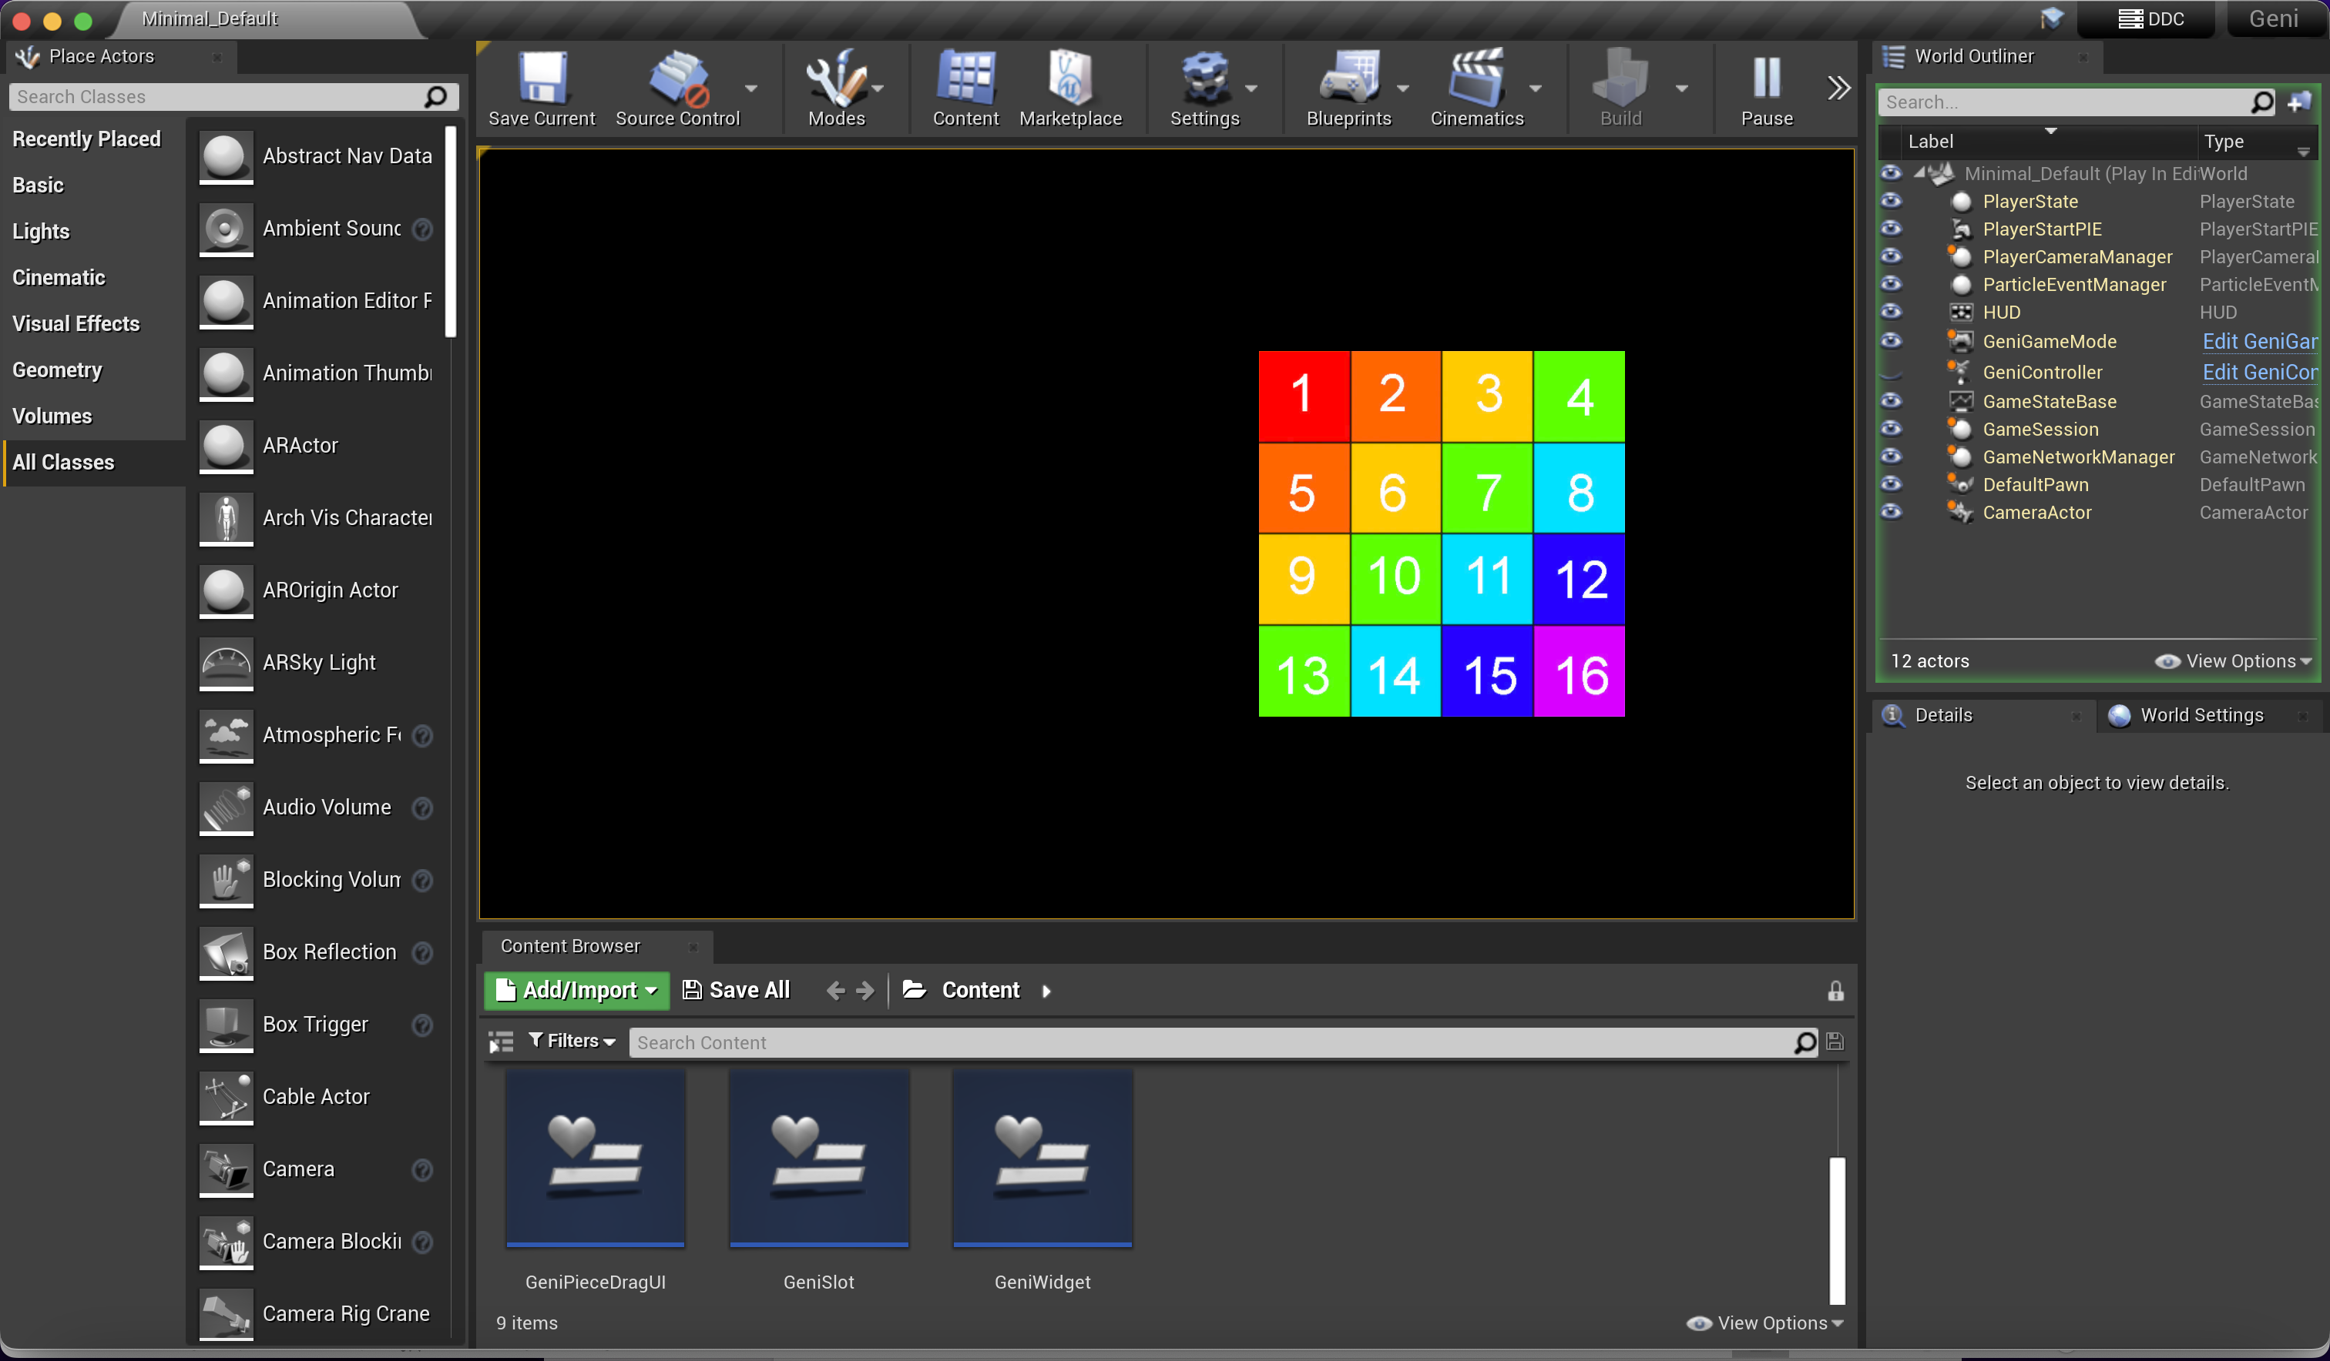
Game Play (Learned Numbers and Sequence)

Slide 8
Activity | January | February | March | April | Total
Concept and design | 06 | NA | 02 | 1 | 09
preparation work | 03 | 03 | 02 | 1 | 09
audio asset search/acquisitio n | NA | 04 | 02 | NA | 06
audio asset cleanup | NA | 01 | 01 | NA | 02
Image, texture asset search/acquisitio n | NA | 01 | 02 | 2 | 05
image asset cleanup | NA | 02 | 02 | 3 | 07
3D asset search/acquisitio n | NA | NA | 02 | NA | 02
3D asset cleanup | NA | NA | 01 | NA | 01
developing in UE | 03 | 03 | 06 | 6 | 18
testing | NA | NA | 01 | 1 | 02
packaging/saving | NA | NA | 04 | 1 | 05
Total | 12 | 14 | 25 | 15 | 66
Work effort in hours for the Simulation
by
Mahfuz Aftab
MDEV1003

Slide 9
Thank You
Mobile Game Design - 01 (MDEV1003)
Assignment: Final Project
Game Title: The Genius Guy
by
Mahfuz Aftab
Student Number: 200499643
Winter 2023

